Slide 1
Investment Strategy for Athens, Greece

Slide 2
Intro to business problem
Greece is rapidly overcoming its financial crisis as financial and economic indices show. There is a large potential for profit.
We focus on the area of the Athens city center.
We use data in order to analyze which investments are considered profitable and which will face large competition and thus have minimal potential for a large market share.

Slide 3
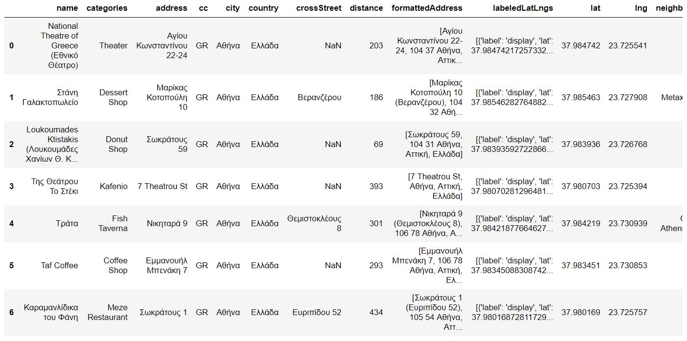
Obtaining Data
We use data from the Foursquare API containing info about venues there

Slide 4
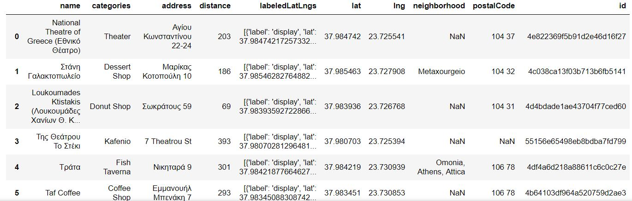
Cleaning the data
We drop unnecessary info.

Slide 5
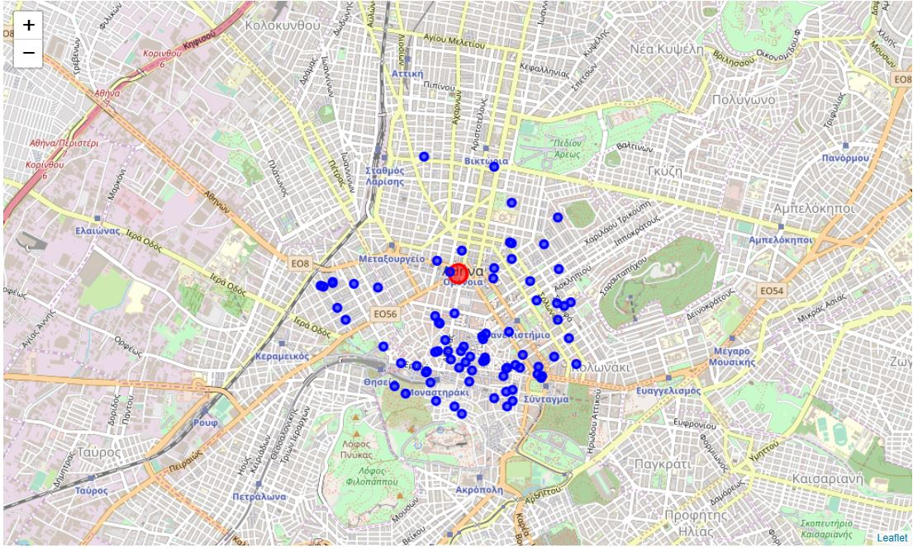
Methodology and exploratory analysis
First we create a spatial visualization of our data and we examine density

Slide 6
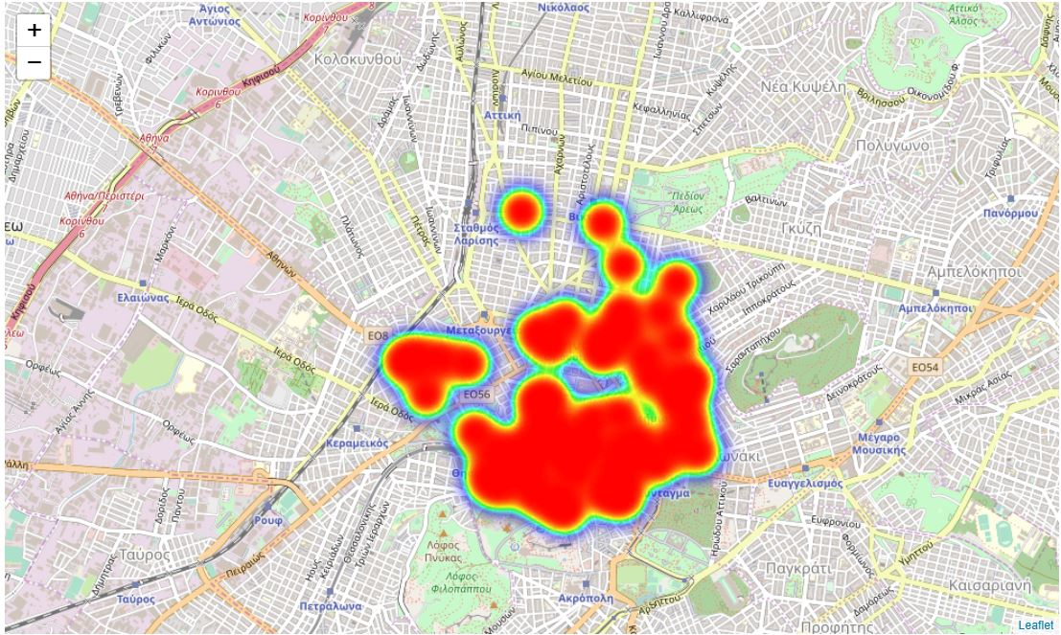
Heatmap
We detect high density south and southeast, thus a heatmap is helpful

Slide 7
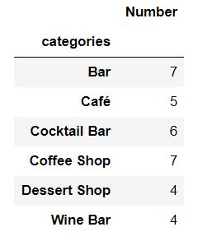
Highest competition
The most present venues are the following. Investors are advised to avoid them due to high competition. They are considered risky.

Slide 8
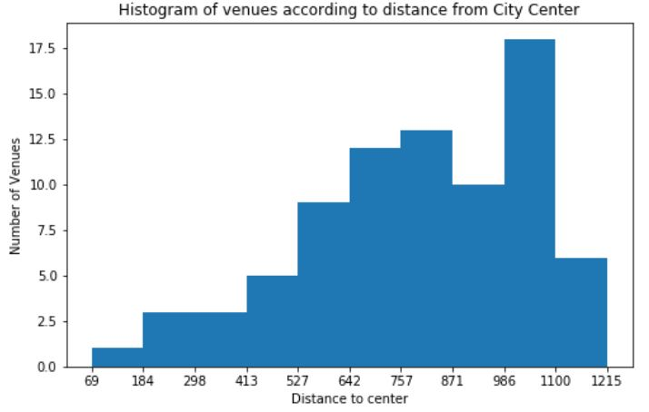
Density according to distance from the city center
Here is the Histogram demonstrating this. There is an opportunity gap between 871 and 986 meters from the city center

Slide 9
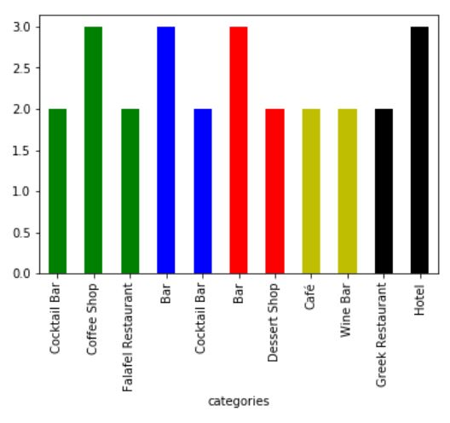
Highest competition grouped with respect to distance from the city center
This is the grouped histogram

Slide 10
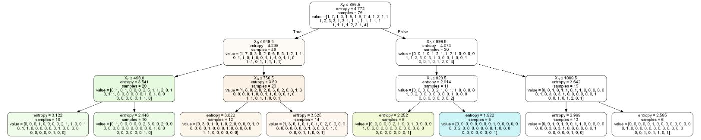
Predictive models (Decision Tree)
Although there is a drop in entropy at each step, it is not significant. The resulting decision tree is pretty inaccurate with accuracy 0.25.

Slide 11
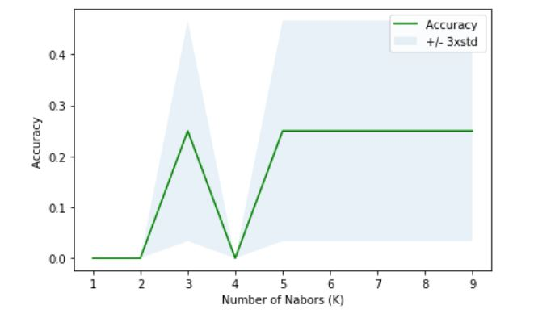
Predictive models (KNN)
The method of K Nearest Neighbors did not prove more accurate. Our data is very limited. Its maximum accuracy is again 0.25. The optimal K’s are shown below

Slide 12
Predictive models (SVM)
Support Vector machine also proved highly inaccurate so we do not include it in our analysis and presentation

Slide 13
Results
Investors should avoid investing on venues contained in the table of high competition above
They should try to expand in a circular way around the city center filling the red cloud of the heatmap
The north areas appear to face less competition
The predictive models proved to be weak so they should not be used to make educated decisions about investments at this point
More data is required such as criminal records, operating costs, profit etc… Those are not accessible for free so beyond the scope of this project

Slide 14
Conclusion and future directions
Accuracy of the models have much room for improvement. This is the future direction
Maps and statistical analysis (Histograms) help the most with our analysis
We performed analysis purely based on location. Investors should conduct further analysis regarding other aspects such as financial and security ones

